Slide 1
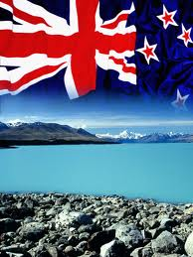
http://theflea.co.nz
Talking racism in Aotearoa

Slide 2
UK: Daily Mail

Slide 3
Overview
Background
Aims and design of this study
Methodology, procedures, participants
Three main discourses
Posttraumatic stress disorder with delayed onset
Conclusion
http://entersoft.co.in/about-eiss/overview.html

Slide 4
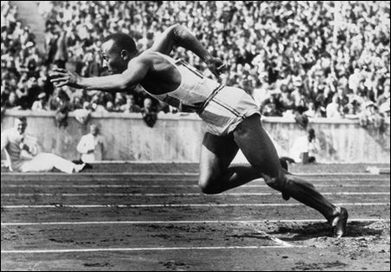
The 1936 Olympic Games in Berlin
Phenotypical racism
Structural, systemic,
institutional racism
Interpersonal or
personally
mediated racism

Slide 5
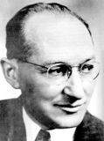
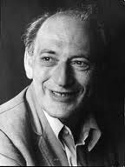
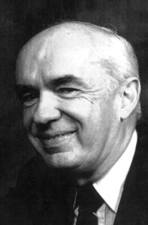
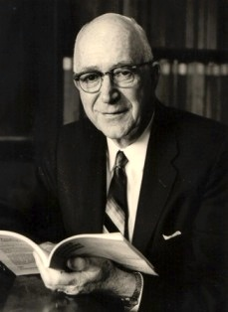
The progression of a psychological etiology
1930s- 1960s
Personality
1970s – 1980s
Social cognition
Adorno
The F-Scale
Lewin
B=f(P,E)
Tajfel
& Turner
Social Identity
Theory
Pettigrew
Ultimate
attribution
error
Allport
Personality
and cognition
Libcom.org, openlearn.open.ac.uk, www.psu.edu, www.isites

Slide 6
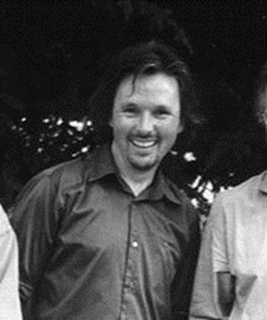
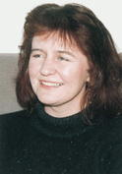
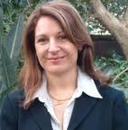
Discourse analysis: Racism and colonialism in NZ
Tuffin
Lyons
Augoustinos
McCreanor
References used available on request

Slide 7
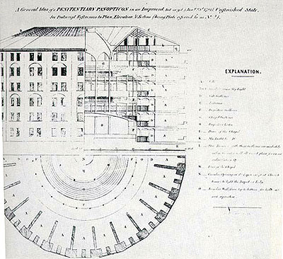
Foucault: state racism
http://legrandfigaro.com, http://www.listal.com

Slide 8
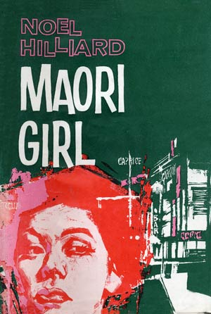
Pākehā and Māori: blatant racism until the 1960s
The Human Rights Act 1993
http://spencer.lib.ku.edu,http://www.topnews.in, http://www.topnews.in

Slide 9
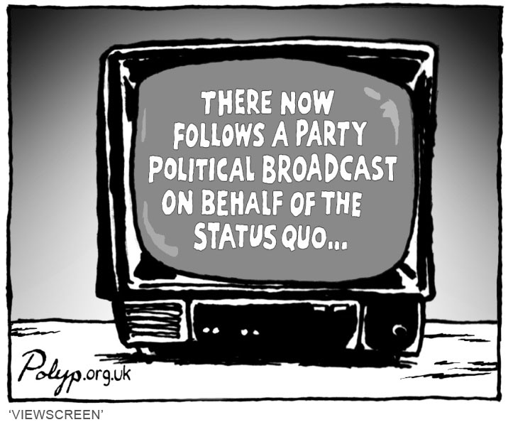
Māori are:
more likely
than Pākehā
to be
apprehended
four to
five times
more likely
to be convicted
Employment, the media, and justice
http://www.cartoonstock.com

Slide 10
Health and chronic stress
- Māori mortality rate for CVD more than two and a half times than that of Pākehā
- stomach cancer mortality three times higher
- rheumatic fever notiﬁcations ﬁve
times higher
- pneumonia rate three times higher
- prevalence of diabetes three times
higher
- hospitalisation for asthma twice as
high

Slide 11
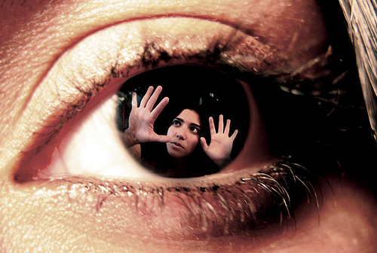
More medical manifestations: Mental Health
In every area considerably lower than that of Pākehā, esp. anxiety disorders
Suicide death rate for Māori youth:
more than double
non-Māori rate
(Ministry of Social
Development, 2010).
http://nutrivize.com/blog/general-health/down-and-out-depression-is-not-romantic/

Slide 12
Sport
Laidlaw, C. (2010). Somebody stole my game. Auckland, New Zealand:
Hachette.
American: “The thinking guys in any football team are all white.
This ain’t prejudice. We have the stats to prove it” (p. 167)
Laidlaw: “we don’t much like talking about these kind of differences in
New Zealand” (p. 167)
Polynesian: “lightning fast” “explosive energy” “sidestepping” “loose” (p. 168)
Pākehā: “marshalled by a dictatorial Pākehā” (p. 166 )
“tight” “hardened” “pragmatic” (p. 168)

Slide 13
Interactive Effects of Racism against Māori in New Zealand
Housing
Racism
Employment
Education
Sport
Health
Mental Health
Media
Justice
Socio-Economic Status
Pack, S. (2012)

Slide 14
Aims of this study
Explore personal accounts of racism against Māori.
Investigate the consequences.
Explore possibilities for positive change in terms of race relations in New Zealand.
Design
1. A qualitative design employing interviews with open ended questions
2. Analysis in the discursive analytic tradition of Potter and Wetherell (1987).

Slide 15
Talking about talk
Hemi and then the other thing is when we talk↑ (.) we tend to cover the whole world before we get to the point? You gotta find the point yourself though you know ((laughs))
Hemi we talk about everything like we’re more concerned about the who::le thi:ng you know rather than that thing and sometimes I think they (Pakeha) don’t understand your way of talking? because even I well I tend to beat around the bush and you come to a conclusion that’s not really a conclusion? ((laughs))
you know what I mean eh↑

Slide 16
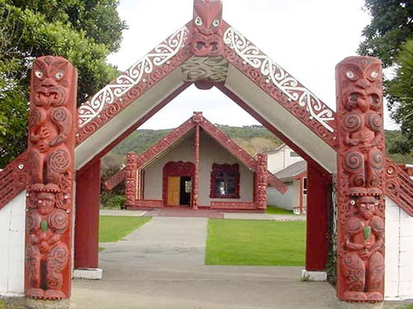
Methods and procedures
Cultural sensitivity
Recruitment:
2 sources
Interviews 1-2 hours
24 Participants
Ages: 30 – 74 years,
mean age 53.
Ethnicity: 19 Māori,
5 non-Māori partners
Occupations: a wide range
including
professionals,
nonprofessionals,
some retirees.

Slide 17
Recruitment Pākehā Māori
I didn’t have to know them; University letterhead on forms sufficient | A need to know and trust interviewer before agreeing
No time needed to socialise | Interviewer spent time talking, eating together
No mistrust | Mistrust of Pākehā research
Researcher privilege expected within reason | Researcher privilege / hegemony suspected and discussed
Expectation that academic research would benefit ‘society’ | The earnest desire for it to improve the lives of Māori
Pack, S. (2012)

Slide 18
Interview process Pākehā Māori
No physical contact No spiritual element Food or drink not mandatory Koha an accepted part of Massey procedure Uninterrupted setting Crisp timing; a limit Seldom stopped tape Answers pinpointed; a ‘scientific’ response Interviewer not expected to comment A quick sign off Interviewer could remain a stranger /acquaintance | Awhi before and after, and/or hongi Prayer possible before or after interview Food and drink required as part of Māori protocol Koha indicated an understanding of the principle of tauutuutu (reciprocity) Mokopuna or relatives might arrive Time was not the essence Frequently stopped tape Larger response: “talking all around the world” “it’s about relationships” Interviewer’s empathy and opinion enquired about Delay getting sign off This was the start of a relationship and a connection
Pack, S. (2012)

Slide 19
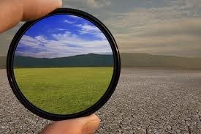
Things are better now than they used to be
Minimise
Excuse
Ngati Kiwi
O
P
T
I
M
I
S
M
http://analyfe.com/tag/optimism/

Slide 20
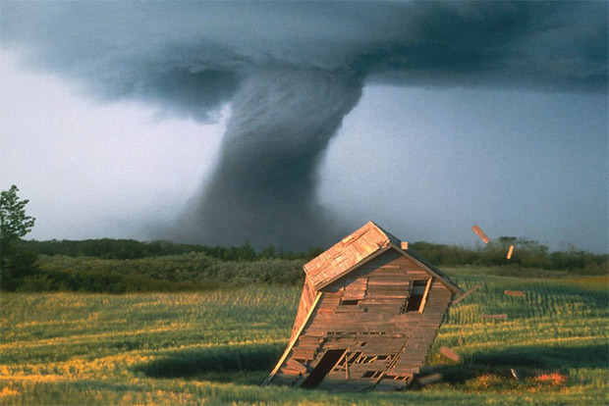
Acceptance
http://www.usernetsite.com/photography/tornadoes.php

Slide 21
Foucauldian racism: a disempowering discourse
Hose Yeah I went to a big school
but there were a lot of people who would (indistinct) you niggers you dumb niggers
Sylvia wow!
Hose dumb Māoris Māoris Māoris you know but just even not saying things properly you know↑ just to antagonise you
Sylvia [indistinct] yeah yeahup
Hose you’re too dumb you know? yeah guys are going what are you doing? often it would be like(.) what’re you doing in a class like I’d be doing science you know
Sylvia mm hm
Hose and it’d be what’s the point in you even trying mate
Sylvia really
Hose you know? ‘cause you’ll end up pushing a broom

Slide 22
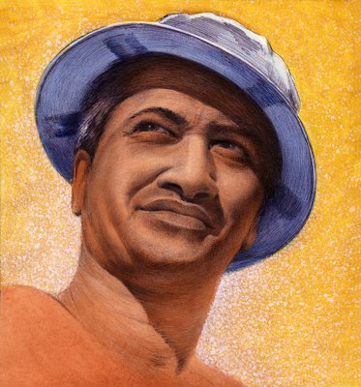
Negative and
erroneous
internalisations
Pākehā
make better
leaders
Pākehā
are more
intelligent
Māori are
funny
looking

Slide 23
Acceptance of state racism
1.
Hoa Well(2) well I think it breeds it does breed a a class of um(2) of ah people that won’t get to their to rise to their potential and I mean I(.)
Sylvia How does that happen?
Hoa I suppose the attitude that you’re not good enough↑(.) you know and that’s the attitude and you accept it
2.
Hana yeah well the funny thing is that when you’re in it you just do it
and you do:::n’t(.) you have a bit of a rail about it but if you grow up with it you know you get used to it and it becomes part of your life?

Slide 24
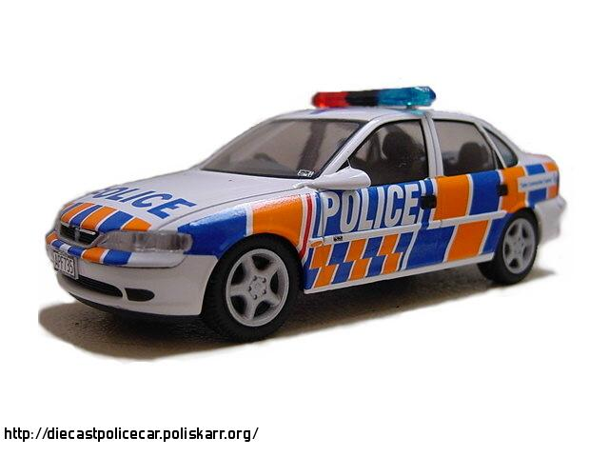

Slide 25
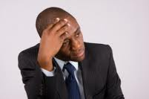
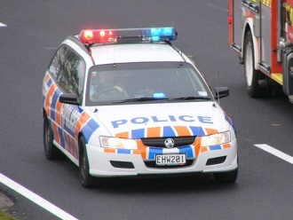
Three discursive enemies to empowerment
Acceptance
Excusing
Internalisation
Pack, S. (2012)

Slide 26
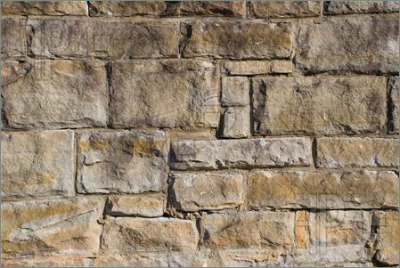
RESISTANCE

Slide 27
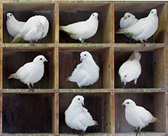
“I’m not going into that little pigeon hole”
http://en.wikipedia.org/wiki/Pigeonhole_principle

Slide 28
Internal
resistance
http://www.ehow.com/how_4894972_write-rebuttal-letter-performance-evaluation.html

Slide 29
external
Resistance
silent
http://nachalooman.wordpress.com

Slide 30
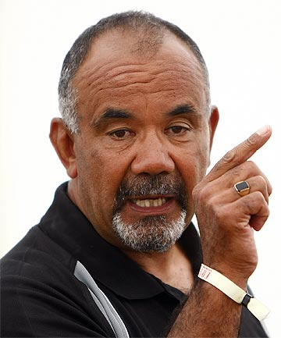
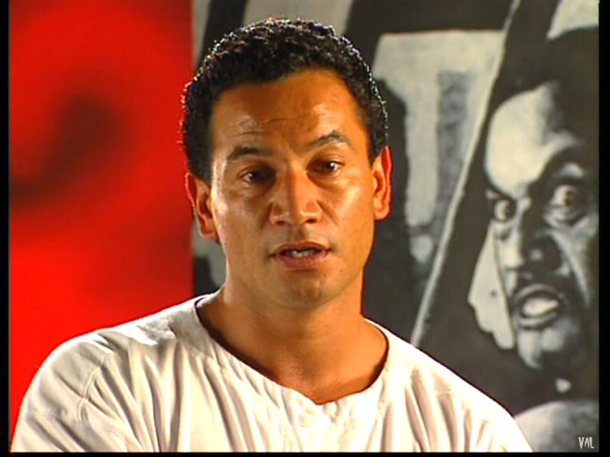
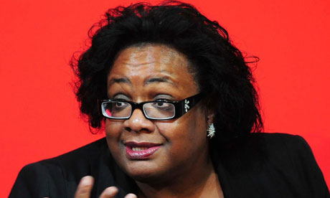
External resistance
spoken
http://www.zimbio.com
http://www.stuff.co.nz/national/politics
http://33revolutionsperminute.wordpress.com

Slide 31
anger - degraded - belittle - offensive - I don’t know
why - disempowering – very upset - hot - mad – agro -
awful – horrible - embarrassing - rubbish - antagonising - hurt - frozen stiff - shock – gobsmacked – unnerved – horrified – astounded – really annoyed – got my ire up – it’s not fair - stressed out - umbrage – sad – alienation – shock - horrified – weep – broke down - very depressing – really sad - lack of self esteem – lack of confidence –
worth nothing
http://govino.co.nz/
‘I can’t remember what I said at the time I just remember how I was made to feel’

Slide 32
Consequences of racism
Hiair because it took me back to my school days and I was crying for no reason and someone asked me why are you what’s wrong and I’d say I don’t know! this went on for days and it wasn’t until a few months later it finally hit me it was all those(.) labels
it took me back to my school days when we were not allowed to speak Maori and we were punished she hurled all this stuff at me and it was like that naughty kid in the corner
I mean after all those years! and I (2) my family all came around and asked me what↑ you know and I explained to them because one time I was in bed↑ and I wouldn’t get up↑ I wouldn’t get up for a couple of days and they kept asking me what’s wrong? And then and then it came flooding out

Slide 33
Conclusions
Racism against Māori in New Zealand society has its roots in colonialism (Potter & Wetherell, Tuffin, McCreanor, Nairn, Lyons)
Modern racism in Aotearoa can be institutional, subtle, or blatant
Feelings engendered by the racism can be remembered for decades
Optimism may include excusing or minimising racism
Acceptance can lead to the internalisation of racist constructions
Resistance is effective, whether internal or verbalised

Slide 34
References
Bhopal, R. (2006). Racism, socioeconomic deprivation, and health in New Zealand. The Lancet, 367(1958-1959).
Fergusson, D. (2003) Ethnicity and Criminal Convictions: Results of a 21-Year Longitudinal Study. The Australian And New Zealand Journal Of Criminology, 36(3), 354-367.
Fergusson D., Horwood L., & Lynskey M. (1993). Ethnicity and bias in police contact statistics. Australian and New Zealand Journal of Criminology 26: 193–206.
Fergusson, D., Swain-Campbell, N., & Horwood, J. (2003a). Is there ethnic bias in conviction rates in New Zealand? Christchurch: Christchurch health and development study, Christchurch School of Medicine.
Fergusson, D., Swain-Campbell, N., & Horwood, J. (2003b). Arrests and convictions for cannabis related offences in a New Zealand birth cohort. Christchurch: Christchurch health and development study, Christchurch School of Medicine.
Harris, R., Tobias, M., Jeffreys, M., Waldegrave, K., Karlsen, S., & Nazroo, J. (2006a). Effects of self-reported racial discrimination and deprivation on Maori health and inequalities in New Zealand: Cross-sectional study. Lancet, 367(9527), 2005-2009.
Harris, R., Tobias, M., Jeffreys, M., Waldegrave, K., Karlsen, S., & Nazroo, J. (2006b). Racism and health: The relationship between experience of racial discrimination and health in New Zealand. Social Science & Medicine, 63(6), 1428-1441.
Human Rights Commission (2006). Human Rights Commission, Te Kahui Tika Tangata Retrieved September 9, 2010, from http://www.hrc.co.nz/
Manatu Hauora, Ministry of Health. Tatau Kahukura: Maori Health Chart Book. Wellington: Ministry of Health. (2006).
McCreanor, T. (1993a). Mimiwhangata: Media reliance on Pakeha Commonsense in Interpretation of Maori Actions. Sites, 26, 79-90.
McCreanor, T. (1993b). Pakeha ideology of Maori performance: A discourse anaytic approach to the construction of educational failure in Aotearoa/New Zealand. Folia Linguistica, 17, 3-4, 293-314.
McCreanor, T. (1994). Settling grievances to deny sovereignty: Trade good for the year 2000. Sites, 27, 45-73.
McCreanor, T. (1997). When racism stepped ashore: Antecedents of anti-Maori discourse in Aotearoa. New Zealand Journal of Psychology, 26(1), 36-44.
Ministry of Health (2002). Diabetes in New Zealand: Models and Forecasts 1996-2011. Retrieved September 6, 2010, from http://www.moh.govt.nz/moh.nsf/0/16a3945b4714f9fccc256b74000f3551?OpenDocumen t
Ministry of Health (2006). About Maori Health. Retrieved Aug 6, 2010, from http://www.maorihealth.govt.nz/moh.nsf/menuma/About+Maori+Health

Slide 35
References cont.
Myers, K.A. (2005). Racetalk: Racism hiding in plain sight. Lanham, Md.: Rowman & Littlefield Publishers, c2005.
Nairn, R., Pega, F., Mccreanor, T., Rankine, J., & Barnes, A. (2006). Media, Racism and Public Health Psychology. Journal of Health Psychology, 11(2), 183-196.
New Zealand Psychological Society (2002). Code of Ethics for Psychologists Working in Aotearoa/New Zealand. Wellington, New Zealand: New Zealand Psychological Society.
Parker, I. (2007). Critical Psychology: What it is and what it is not. Retrieved March 25th 2008 from http://www.blackwell-synergy.com/doi/pdf/10.1111/j.1751-9004.2007.00008.x?cookieSet=1.
Potter, J., & Wetherell, M. (1987). Discourse and social psychology: Beyond attitudes and behaviour. London: Sage.
Reading, R. (2004). Review of Maternal depressive symptoms and adherence to therapy in inner-city children with asthma. Child: Care, Health and Development, 30(4), 397.
Robson, B. (2008) What is driving the disparities? In K. Dewe and A. Matheson (Eds.), Understanding health inequalities in Aotearoa New Zealand. Dunedin, New Zealand: Otago University Press.
Robson, B., Purdie, G., & Cormack, D. (2010). Unequal impact II: Maori and nonMaori Cancer Statistics by deprivation and Rural-urban Status 2002-2006. Wellington: Ministry of Health. Retrieved September 8, 2010, from http://www.maorihealth.govt.nz/
Sutherland, H., & Alexander, R. (2002). The occupational distribution of Māori 1997-2000. Dunedin: Department of Economics, University of Otago.
Tajfel, H. (1978). Social categorization, social identity and social comparison. In H. Tajfel (Ed.), Differentiation between social groups: Studies in the social psychology of intergroup relations. London: Academic Press.
Thomas, D. R. (1993). What are Bicultural Psychological Services. (March), 31-39.
Turei, L. (2004). Bigotry's subtle face. Press, 3 May 2004, A2013.
Vaughan, G. M. (1988). The psychology of intergroup discrimination. New Zealand Journal of Psychology, 17(1), 1-14.
Wakefield, E. G. (1837). The British Colonisation of New Zealand. London: J. W. Parker.
Ward, J. (1839). Information relative to New Zealand. London: J.W. Parker.
Warren-Findlow, J. (2006). Weathering: Stress and Heart Disease in African American Women Living in Chicago. Qualitative Health Research, 16(2), 221-237.
Wetherell, M., & Potter, J. (1988). Discourse analysis and the identification of interpretive repertoires. In C. Antaki (Ed.), Analysing everyday explanation. London: Harvester Wheatsheaf.
Wetherell, M., & Potter, J. (1992). Mapping the language of racism: Discourse and the legitimation of exploitation. New York, NY, US: Columbia University Press.

Slide 36
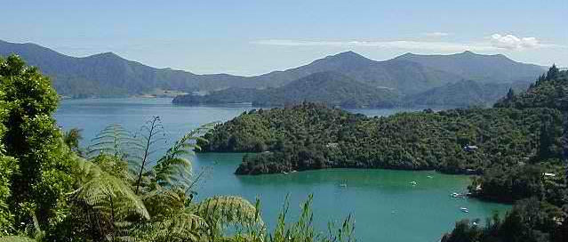
Discursive studies in Aotearoa
Racism in colonial power structures
Tuffin, K., 2008; Tuffin, K., Praat, A., & Frewin, K., 2004; Nairn, R., & McCreanor, T., 1990, 1991; McCreanor, T., 1997, 1989, 2005; Bell, C., 1996; Hokowhitu, B., 2003, 2004; Lyons, A., Madden, H., Chamberlain, K., & Carr, S. 2011.
Racism in NZ has become modern, subtle, covert
Tuffin, K., 2005, 2008; Tuffin, K., Morgan, M., Frewin, K., & Jardine, A., 2000; Liu, J., 2006
Media’s role in maintaining and reproducing colonial power structures
Nairn, R., Pega, F., McCreanor, T., Rankine, J., & Barnes, A., 2006; McCreanor, T., 1993, 2008; McGregor, J., & Te Awa, J., 1996; Rankine, J., & McCreanor, T., 2004; Lehrman, S., 2007.
Racism and health
Harris, R., Tobias, M., Jeffreys, M., Waldegrave, K., Karlsen, S., & Nazroo, J. 2006; Nairn, R., Pega, F., McCreanor, T., Rankine, J., & Barnes, A. 2006
Racism and education
McCreanor, T., 1993, Bennett, S., 2002.
Combating racism
Guerin, B, 2003.

